Slide 1
Experiences with long COVID:
Narrative evidence from 8 countries
Nikola Biller-Andorno, Prof. Dr. med. Dr. phil.
Director
Institute of Biomedical Ethics and History of Medicine (IBME)
University of Zürich

Slide 2
Long COVID: What is it?
Patients themselves identified and pushed for recognition of long COVID in 2020
While definitions of long COVID vary, people across the world are experiencing prolonged symptoms, for up to 2 years
Most debilitating symptoms include:
breathlessness
fatigue
cardiovascular problems
neurological symptoms
memory and concentration issues (brain fog)

Slide 3
Long COVID: A global Concern
Based on WHO estimates of 470 million worldwide COVID-19 infections, evidence suggests as many as “200 million individuals currently experience or have previously experienced long-term health health-related consequences of COVID”
Some people may not report symptoms or recognise them as COVID-related
Chen C, Haupert SR, Zimmermann L, Shi X, Fritsche LG, Mukherjee B. Global Prevalence of Post COVID-19 Condition or Long COVID: A Meta-Analysis and Systematic Review. J Infect Dis. 2022 Apr 16

Slide 4
DIPEx International (DI)
An association of academic and non-profit groups around the world committed to understanding health and illness experiences globally
All use the DIPEx methodology for rigorously collecting and analysing qualitative health experience interviews and disseminating on web
Hundreds of peer-reviewed publications
DI began cross-national studies of COVID in Summer 2020 to understand universal themes as well as differences by culture and national context

Slide 5
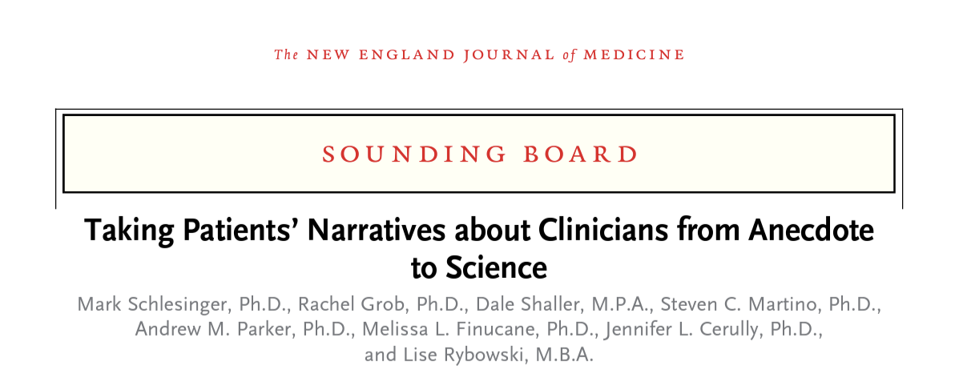
DIPEx long COVID studies
8 countries
167 interviews conducted mostly between January 2021 and present
Rapid cross-national comparison to derive relevant themes
In the UK, patient narratives recognized as a source of patient experience evidence for NICE guideline developers (National Institute for Health and Care Excellence)

Slide 6
Common themes on long COVID
Symptoms are diverse and disruptive
Sickness and welfare support/benefits are often hard or impossible to get, but essential
In many countries, health systems are struggling to cope with referrals
Clinicians have few treatments; patients value being listened to and believed
Some people opt not to seek care at all, for various reasons
People with long COVID suggest better public messaging

Slide 7
Montage
Notes:
Link to montage in Box file just in case: https://uwmadison.box.com/s/9ggexdcy4fdarkykqn3k7j0lb6lfyrwu

Slide 8
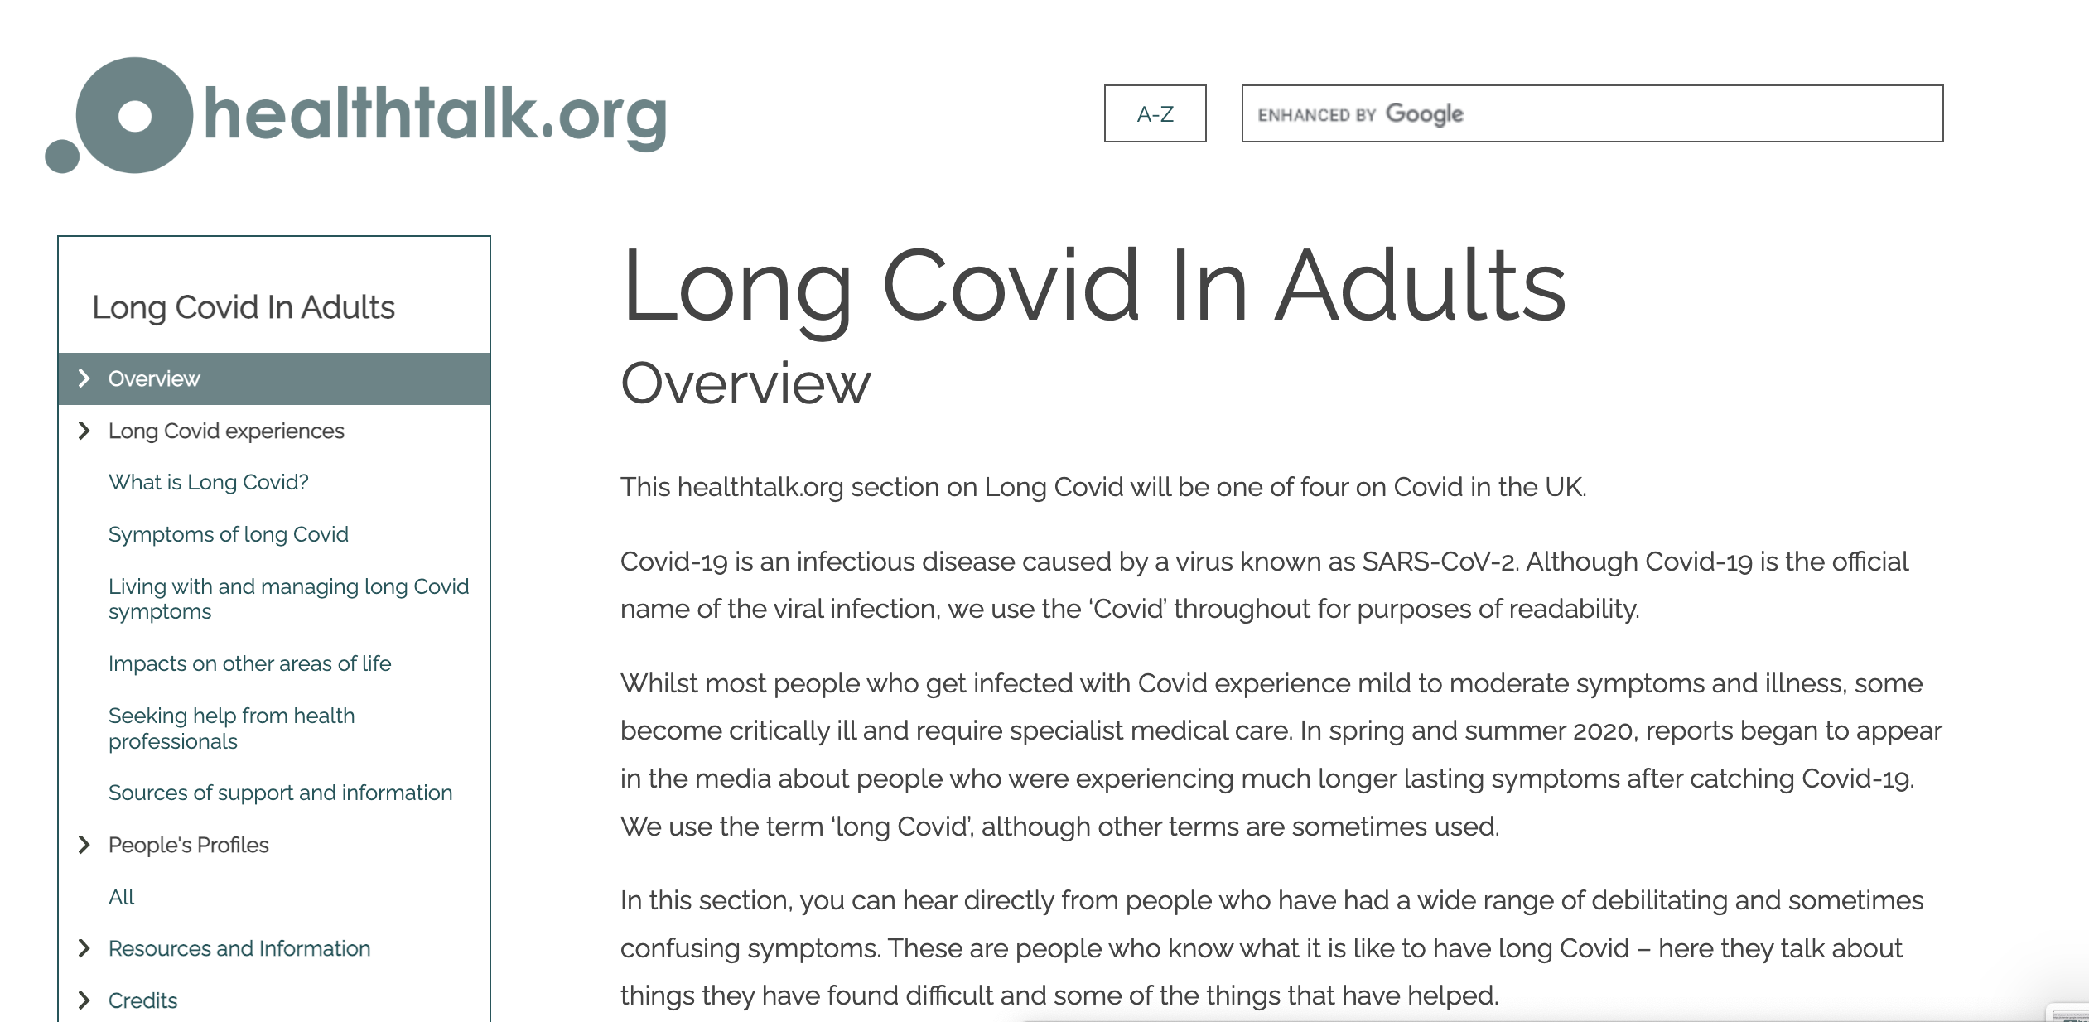
DIPEx long COVID sites in progress
United Kingdom
Japan

Slide 9
How narratives might inform WHO’s work
Continue to build WHO communication strategies around long COVID
Use patient narratives to develop messaging?
Use rigorously elicited and analysed narratives as a source of evidence to inform WHO response
Video montage?
Professional catalyst film?
White paper style summary of findings?

Slide 10
Acknowledgements
Australia
Brazil
Canada
Japan
Netherlands
Spain
United Kingdom
United States

